Slide 1
Getting started with PayPAL mobile payments
Jim DiZoglio - @jimdizoglio
Paypal Mobile SDK and Client

Slide 2
Getting started with mobile payments
MobilePaymentsLibraryWorkshop.zip - unzip the package on your desktop
Eclipse - installed with the Android SDK required

Slide 3
Objectives
Understand how to integration Paypal's Mobile Payments Library (MPL) into your application
Initialize the payments library
Understanding how to create Paypal payments
Specify payment type
Simple payments
Chained payments
Create a payment transaction
How to create an invoice and add items
How to launch the checkout process

Slide 4

Native app solutions
Mobile Payments Library (MPL) is a fully native application solution
All native solution, initialize once, add items to shopping cart and checkout
Mobile Express Checkout Library (MECL) is a native application solution with checkout on the web
Integrates with your merchant services, allows customers to shop and checkout from your mobile application

Slide 5
MPL Simplified
MPL checkout process

Slide 6
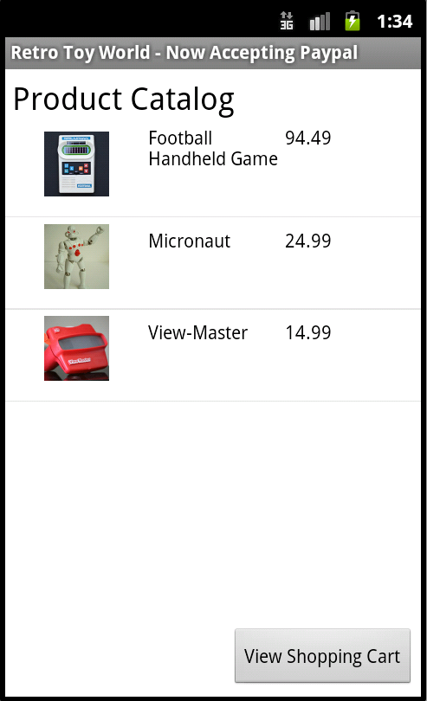
MPL - Our lab.
We are going to add MPL to a shopping cart application. Four our first set of labs, we will send a simple payment using the PayPalPayment object, allowing our customers to purchase goods. This is a single recipient transaction.

Slide 7
MPL Lab 01 – Adding MPL to our project
Launch Eclipse and open the project Lab-01
File->New->Android Project
Check create project from existing source and open the directory lab-01
PayPalMobilePaymentsShoppingCartActivity

Slide 8
MPL Lab 01 – Adding MPL to our project
MPL library, PayPal_MPL.jar is located in the ‘MPL Library’ directory found in the root of MobilePaymentsLibraryWorkshop
To add the library to the project.
Project->Properties or right-click the project -> properties.
Select ‘Java Build Path’ and the ‘Libraries’.
Click ‘Add External Jar’s…’
Navigate to ’PayPal_MPL.jar’, click open and your will see the jar list in the build path.
Click OK.

Slide 9
MPL Lab 01 – Adding MPL to our project
Add the MPL activity to the AndroidManifest.xml file
Open the manifest file and select ‘AndroidManifest.xml’ tab
Uncomment the activity
Build the project, no errors and MPL is now available to the application
<activity android:name="com.paypal.android.MEP.PayPalActivity"
android:theme="@android:style/Theme.Translucent.NoTitleBar"
android:configChanges="keyboardHidden|orientation"/>

Slide 10
MPL Lab 02 – Initializing MPL and adding return handlers
Overview
Create a payments class, SimpleDemo.java
Create an MPL hander class, ResultsDelegate.java
Add SimpleDemo intent to the PayPalMobilePaymentsShoppingCartActivity

Slide 11
MPL Lab 02 – Initializing MPL and adding return handlers
Create a SimpleDemo class (included in lab project)
public class SimpleDemo extends Activity
Add activity to the manifest
Open ‘AndroidManifest.xml’ tab and uncomment the activity
<activity android:name=".SimpleDemo" />

Slide 12
MPL Lab 02 – Initializing MPL and adding return handlers
Import MPL payments class into SimpleDemo
Set your Paypal environment. This is either ENV_LIVE or ENV_SANDBOX.
Set your application id. Live App ID issued by xcom registration. We will use the sandbox default.
import com.paypal.android.MEP.PayPal;
private static final int server = PayPal.ENV_SANDBOX;
private static final String appID = "APP-80W284485P519543T";

Slide 13
MPL Lab 02 – Initializing MPL and adding return handlers
Initialize MPL
From OnCreate call our initialization routine from a thread
private void initLibrary() {
PayPal pp = PayPal.getInstance();
// If the library is already initialized, then we don't need to initialize it again.
if(pp == null) {
// This is the main initialization call that takes in your Context
// the Application ID, and the server you would like to connect to.
pp = PayPal.initWithAppID(this, appID, server);
}
}

Slide 14
MPL Lab 02 – Initializing MPL and adding return handlers
Configure our MPL instance after we initialize
Set the language – (ISO 639-1 and ISO 3166-1)
Set the payments fees (FEEPAYER_SENDER, FEEPAYER_PRIMARYRECEIVER, FEEPAYER_EACHRECEIVER, and FEEPAYER_SECONDARYONLY)
Tells MPL who to charge the fee to. In our demo, the receiver will pay the fee.
pp.setLanguage("en_US");
pp.setFeesPayer(PayPal.FEEPAYER_EACHRECEIVER);

Slide 15
MPL Lab 02 – Initializing MPL and adding return handlers
Tell MPL if shipping charges will be added to the transaction
Use Dynamic Amount Calculation when you need to determine tax and shipping amounts based on the user's shipping address.
Shipping must be enabled for Dynamic Amount Calculation
Requires you to create a class that implements PaymentAdjuster and Serializable (Example found in MPL Demo’s on xcom)
pp.setShippingEnabled(true);
pp.setDynamicAmountCalculationEnabled(false);

Slide 16
MPL Lab 02 – Initializing MPL and adding return handlers
Implement our MPL Results Delegate (included in lab project)
In the ResultsDelegate class, import the MPL and Serializable class
and implement these classes
import java.io.Serializable;
import com.paypal.android.MEP.PayPalResultDelegate;
public class ResultDelegate implements PayPalResultDelegate, Serializable

Slide 17
MPL Lab 02 – Initializing MPL and adding return handlers
Add our MPL result delegates to our application
Notification that the payment has been completed successfully
Notification that the payment has failed
Notification that the payment was canceled
public void onPaymentSucceeded(String payKey, String paymentStatus) {…}
public void onPaymentFailed(String paymentStatus, String correlationID,
String payKey, String errorID, String errorMessage) {…}
public void onPaymentCanceled(String paymentStatus) {…}

Slide 18
MPL Lab 02 – Initializing MPL and adding return handlers
Add Handler for MPL to report it’s initialization progress
Add a method to update the status. Here is a failure message
Handler hRefresh = new Handler(){
…
};
public void showFailure() {
title.setText("FAILURE");
info.setText("Could not initialize the PayPal library.");
title.setVisibility(View.VISIBLE);
info.setVisibility(View.VISIBLE);
}

Slide 19
MPL Lab 02 – Initializing MPL and adding return handlers
Let’s enable the shopping cart
Add a SimpleDemo intent to our apps. Add the following Intent to PayPalMobilePaymentsShoppingCartActivity class
Build without error and run, we are initializing MPL and handling the results
Button viewShoppingCart = (Button) findViewById(R.id.ButtonViewCart);
viewShoppingCart.setOnClickListener(
new OnClickListener() {
@Override
public void onClick(View v) {
Intent viewShoppingCartIntent = new Intent(getBaseContext(),
SimpleDemo.class);
startActivity(viewShoppingCartIntent);
}
});

Slide 20
MPL Lab 03 – Adding MPL UI checkout button to our application
Import MPL payments buttons class into SimpleDemo
Implement the onClickListener in SimpleDemo
Declare our Paypal checkout button member variable
import com.paypal.android.MEP.CheckoutButton;
public class SimpleDemo extends Activity implements OnClickListener
CheckoutButton launchSimplePayment;

Slide 21
MPL Lab 03 – Adding MPL UI checkout button to our application
Create our CheckoutButton and update the UI
public void setupButtons() {
PayPal pp = PayPal.getInstance();
// Get the CheckoutButton. There are five different sizes.
// The text on the button can either be of type TEXT_PAY or TEXT_DONATE.
launchSimplePayment = pp.getCheckoutButton(this, PayPal.BUTTON_194x37, CheckoutButton.TEXT_PAY);
// You'll need to have an OnClickListener for the CheckoutButton.
// For this application, MPL_Example implements OnClickListener and we
// have the onClick() method below.
launchSimplePayment.setPadding(40, 15, 40, 15);
launchSimplePayment.setOnClickListener(this);
// The CheckoutButton is an android LinearLayout so we can add it to our display like any other View.
layoutSimplePayment.addView(launchSimplePayment);
info.setText("");
info.setVisibility(View.GONE);
}

Slide 22
Call the setupButtons method when MPL initialization completes
Handler hRefresh = new Handler(){
@Override
public void handleMessage(Message msg) {
switch(msg.what) {
case INITIALIZE_SUCCESS:
setupButtons();
break;
case INITIALIZE_FAILURE:
showFailure();
break;
}
}
};

Slide 23
MPL Lab 03 – Adding MPL UI checkout button to our application
Add the activity result handler to SimpleDemo
Build without error and run, after MPL initializes, we should see our ‘Pay with Paypal’ button appear in our shopping cart.
public void onActivityResult(int requestCode, int resultCode, Intent data) {
if(requestCode != request)
return;
…
launchSimplePayment.updateButton();
}

Slide 24
MPL Lab 04 – Creating a simple payment
Overview
A simple payment consists of a PaypalPayment object, one recipient, any number of items with unit price, order total, tax and/or shipping and merchant information.
Import MPL payments and invoice classes into SimpleDemo
Create a simple payments method in our SimpleDemo class
import com.paypal.android.MEP.PayPalInvoiceData;
import com.paypal.android.MEP.PayPalInvoiceItem;
import com.paypal.android.MEP.PayPalPayment;
private PayPalPayment exampleSimplePayment() {…}

Slide 25
MPL Lab 04 – Creating a simple payment
Create a simple payment object in our exampleSimplePayments method
Tell MPL about our merchant (recipient) account information
Merchant currency, account and ID
Merchant name that will appear in checkout cart
Integrate and automate your Instant Payment Notification (IPN)
PayPalPayment payment = new PayPalPayment();
payment.setCurrencyType("USD");
payment.setRecipient("example-merchant-1@paypal.com");
payment.setCustomID("8873482296");
payment.setMerchantName("The Retro Toy Store"); payment.setIpnUrl("http://www.exampleapp.com/ipn");

Slide 26
MPL Lab 04 – Creating a simple payment
Detail payment information:
Payment type(PAYMENT_TYPE_GOODS, PAYMENT_TYPE_SERVICE, PAYMENT_TYPE_PERSONAL)
Add a memo to the customer
payment.setPaymentType(PayPal.PAYMENT_TYPE_GOODS);
payment.setMemo("Coupon for 10% off next purchase");

Slide 27
MPL Lab 04 – Creating a simple payment
Create an invoice object for checkout and add it to our payments object
Can contain tax and shipping information
Contains our items for checkout
Create items and add them to our invoice object
PayPalInvoiceData invoice = new PayPalInvoiceData();
…
payment.setInvoiceData(invoice);
PayPalInvoiceItem item = new PayPalInvoiceItem();
…
invoice.getInvoiceItems().add(item);

Slide 28
MPL Lab 04 – Creating a simple payment
Tell MPL about the customers shopping cart items:
Create an item, set item name, item ID, quantity, unit price and total. Add that item to the invoice.
PayPalInvoiceItem item = new PayPalInvoiceItem();
item.setName(mCartList.get(i).title);
item.setID(mCartList.get(i).itemId);
item.setQuantity(ShoppingCartHelper.getProductQuantity(mCartList.get(i)));
BigDecimal unitPrice = new BigDecimal(mCartList.get(i).price);
item.setUnitPrice(unitPrice);
BigDecimal quantity = new BigDecimal(ShoppingCartHelper.getProductQuantity (mCartList.get(i)));
item.setTotalPrice(unitPrice.multiply(quantity));
total = total.add(unitPrice.multiply(quantity));
invoice.getInvoiceItems().add(item);

Slide 29
MPL Lab 04 – Creating a simple payment
Set the total amount of the payment, not including tax and shipping amounts.
Set the orders tax and shipping amounts
Add the invoice to the payment and complete payment details
We’ve completed a simple Payment
payment.setSubtotal(total);
BigDecimal totalTax = new BigDecimal("0.085");
invoice.setTax(totalTax.multiply(total));
invoice.setShipping(new BigDecimal("7.50"));
payment.setInvoiceData(invoice);

Slide 30
MPL Lab 04 – Creating a simple payment
Connecting the payment to our application.
Add a checkout call to our ‘Pay with Paypal’ OnClick
Call checkout with the payment object
public void onClick(View v) {
if(v == launchSimplePayment) {
// Use our helper function to create the simple payment.
PayPalPayment payment = exampleSimplePayment();
// Use checkout to create our Intent.
Intent checkoutIntent = PayPal.getInstance().checkout (payment, this, new ResultDelegate());
// Use the android's startActivityForResult() and
// pass in our Intent. This will start the library.
startActivityForResult(checkoutIntent, request);
}
}

Slide 31
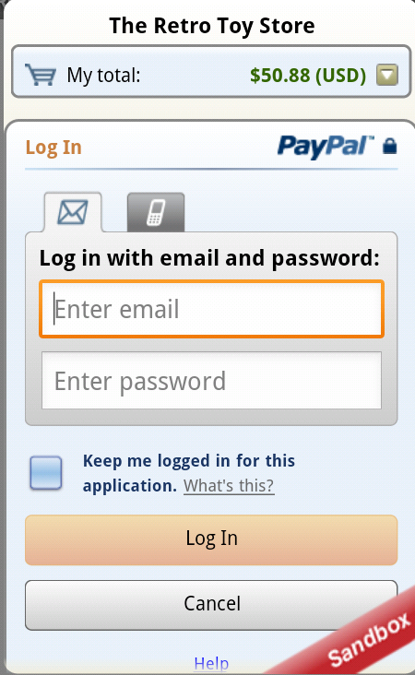
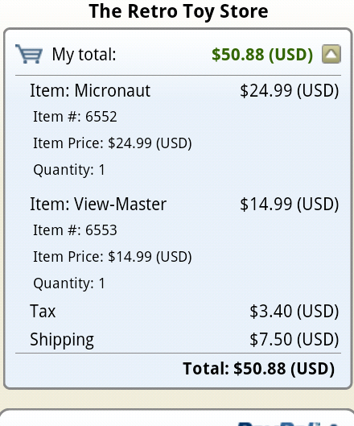
MPL Lab 04 – Creating a simple payment
Build and Run. We are now able to complete a simple payment using Paypal’s mobile payments library
You can complete the checkout as using your customer sandbox account. The payment information is viewable from both the merchant and buyer accounts.

Slide 32
MPL Lab 05 – Creating a chained payment
Chained Payment - A payment with multiple receivers in which one receiver is designated as primary

Slide 33
MPL Lab 05 – Creating a chained payment
In our example, we will create a travel agent application. We will collect the payment and send 58% to the airlines and 40% to the hotel, keeping our fee of 2%.
We will use the the shopping application from Retro toys and create class called ChainedPayments, importing the PayPalAdvancedPayment and PayPalRecieverDetails classes.
import com.paypal.android.MEP.PayPalAdvancedPayment;
import com.paypal.android.MEP.PayPalReceiverDetails;
public class ChainedPaymentsDemo extends Activity implements OnClickListener {…}

Slide 34
MPL Lab 05 – Creating a chained payment
Create a exampleChainedPayment method
Create an advanced payment object in our exampleChainedPayment method
Fill in the payment details: currency, IPN and demo.
Merchant information will be set via PayPalReceiverDetails
private PayPalAdvancedPayment exampleChainedPayment()
PayPalAdvancedPayment payment = new PayPalAdvancedPayment();

Slide 35
MPL Lab 05 – Creating a chained payment
Creating payment receivers
Set the first receiver information
Mark this receiver as primary
Set the payment type to services
Create an invoice and add the item same as SimpleDemo
PayPalReceiverDetails receiver1 = new PayPalReceiverDetails();
receiver1.setRecipient("example-merchant-1@paypal.com");
receiver1.setIsPrimary(true);
receiver1.setPaymentType(PayPal.PAYMENT_TYPE_SERVICE);
receiver1.setMerchantName("World of Travel");
receiver1.setDescription("A chain payment primary");.
receiver1.setCustomID("55342");

Slide 36
MPL Lab 05 – Creating a chained payment
Add the invoice to the primary receiver and set the transaction subtotal not including tax amount.
The primary receiver receivers the total of the transaction.
Add the receiver object to the advanced payments object.
receiver1.setInvoiceData(invoice1);
receiver1.setSubtotal(total);
payment.getReceivers().add(receiver1);

Slide 37
MPL Lab 05 – Creating a chained payment
Create the hotels receiver and mark them as secondary.
Set the amount of the payment they will receive and add them to the advanced payments object.
PayPalReceiverDetails receiver2 = new PayPalReceiverDetails();
receiver2.setRecipient("example-merchant-2@paypal.com");
BigDecimal hotelsTotal = new BigDecimal("0.40");
receiver2.setSubtotal(hotelsTotal.multiply(total));
receiver2.setIsPrimary(false);
receiver2.setPaymentType(PayPal.PAYMENT_TYPE_SERVICE);
receiver2.setMerchantName("Best Hotels");
receiver2.setDescription("One of the chain payment secondaries");
receiver2.setCustomID("93675");
payment.getReceivers().add(receiver2);

Slide 38
MPL Lab 05 – Creating a chained payment
Create the hotels receiver and mark them as secondary.
Set the amount of the payment they will receive and add them to the advanced payments object.
PayPalReceiverDetails receiver3 = new PayPalReceiverDetails();
receiver3.setRecipient("example-merchant-3@paypal.com");
BigDecimal airlinesTotal = new BigDecimal("0.58");
receiver3.setSubtotal(airlinesTotal.multiply(total));
receiver3.setIsPrimary(false);
receiver3.setPaymentType(PayPal.PAYMENT_TYPE_SERVICE);
receiver3.setMerchantName("Best Airlines");
receiver3.setDescription("One of the chain payment secondaries");
receiver3.setCustomID("78853");
payment.getReceivers().add(receiver3);

Slide 39
MPL Lab 05 – Creating a chained payment
Connecting the payment to our application.
Add a checkout call to our ‘Pay with Paypal’ OnClick
Call checkout with the advanced payment object
public void onClick(View v) {
if(v == launchChainedPayment) {
// Use our helper function to create the chained payment.
PayPalAdvancedPayment payment = exampleChainedPayment();
// Use checkout to create our Intent.
Intent checkoutIntent = PayPal.getInstance().checkout(payment, this, new ResultDelegate());
// Use the android's startActivityForResult() and pass in our Intent.
// This will start the library.
startActivityForResult(checkoutIntent, request);
}
}

Slide 40
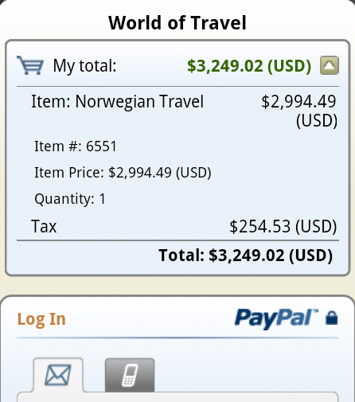
MPL Lab 05 – Creating a chained payment
Build and Run. We are now able to complete a chained payment using Paypal’s mobile payments library
You can complete the checkout as using your customer sandbox account. Notice the customer see’s only the primary receiver during checkout

